Slide 1
Expression Platform Paper Figures
7/7/23
Lisa Hansen

Slide 2
Notes:
Q: How best could the incumbent and substrate ??
Figure 1A: Strand invasion within the purine riboswitch. (A) schematic of secondary structure of the minimized pbuE riboswitch P4-A. Notable regions for stand invasion highlighted: incumbent strand (orange), substrate strand (magenta), and invader (green). (B) Strand invasion schematic with purine riboswitch as system. Top row shows processes in absence of ligand, bottom row shows with ligand. Initiation begins with three strands in proximity, followed by toehold formation involving pairing of P4 with or without ligand. Branch migration proceeds when the invader strand begins pairing in P1 and proceeds into P3 until full displacement occurs. All steps are in reversible except for displacement because no toehold is available for the incumbent.

Slide 3
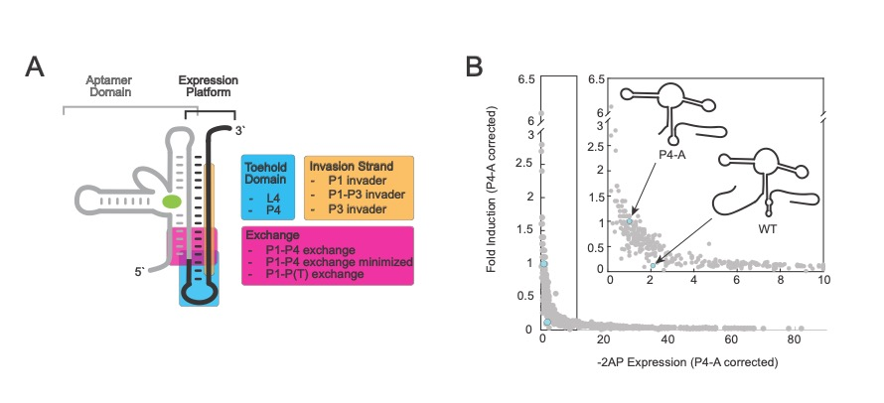
Notes:
Figure 2: A genetic screen of the expression platform through multiple libraries. (A) Schematic of riboswitch highlighting areas of interest for genetic screen. Aptamer domain in gray, expression platform in black and ligand shown in green. The toehold domain libraries (blue), exchange libraries (magenta) and invasion strand libraries (yellow) are listed (right) and highlighted on RNA (left). RNA shows all possible competing base pairs in ON or OFF state. (B) All variants from all libraries displayed on one axis (gray) with the wildtype pbuE riboswitch (WT) and parental P4-A riboswitch in cyan. Inset shows variants with -2AP expression >10-times that of P4-A.

Slide 4
Notes:
Figure 3: A genetic screen of the toehold libraries. (A) Schematic of P4-A with the P4 (magenta) and L4 (yellow) libraries highlighted. To right on top is schematic of secondary structure of stem loop 4 with the sequence. Residue implicated in elemental pausing, position -11, -10, -1 and +1, highlighted in cyan. On bottom is schematic of P4 helix showing naming of the 3 base pairs in P4 in white to right of paired region. One base pair of P1 included in gray to show that BP1 participates in P1 and P4. (B) L4 variants plotted in yellow on same axis as Figure 2B. P4-A and WT in cyan. Inset includes sequence of P4-A (top with arrow) and the sequence logo of all library variants. Logo includes regions of the non-randomized P4 region with elemental pausing numbered on x-axis. (C) TBD (D) P4 variants plotted in magenta, P4-A and WT shown in cyan. Inset shows variants with -2AP expression >10-times that of P4-A. (E) Pie charts illustrating base pair identity for 3 positions. BP1-3 labeled on left, first column includes all variant, second column super performers, third is top performers and fourth includes all remaining sequences. (F) Activity of specific variants with schematic of sequence above each variant. Error bars show SEM.

Slide 5
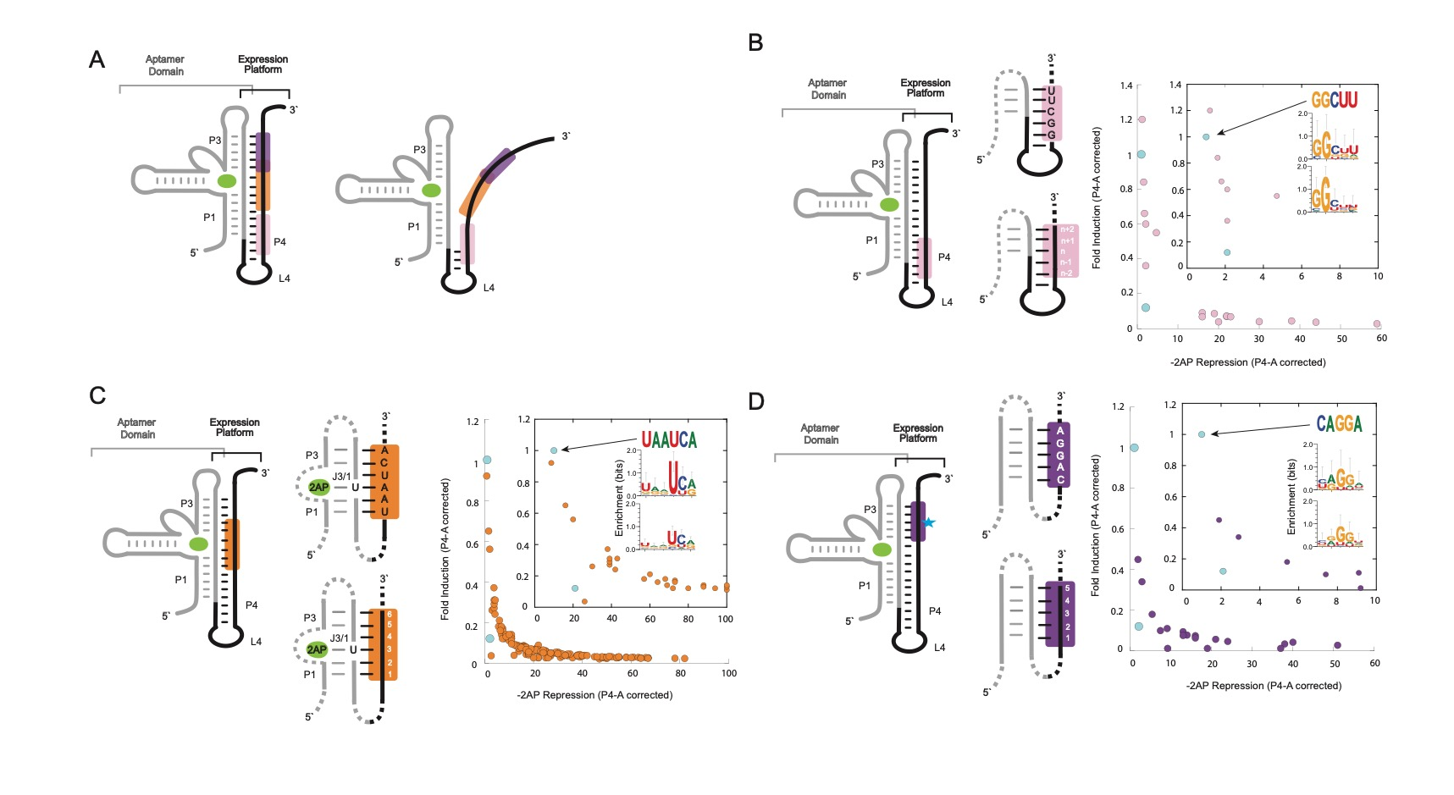
Notes:
Figure 4: A genetic screen of the invader libraries. (A) Schematic of three libraries highlighted on pbuE riboswitch. All base pairs represented on right, intact aptamer domain and single stranded invader strand on left. P1 invader in pink, P1-P3 invader in orange, and P3 invader in purple. (B) P1 invader highlighted on pbuE schematic, highlight consistent with A. P1-P4 area schematized (middle), primary sequence of library (top) and number system of base pairs (bottom) shown. P1 invader variants plotted in pink on same axis as Figure 2B. P4-A and WT in cyan. Inset is zoomed-in plot -2AP repression values <=10. The inset includes sequence of P4-A (top with arrow) and the sequence logo of variants in inset plot (middle), sequence logo of all variants (bottom). (C) P1-P3 invader highlighted on pbuE schematic, highlight consistent with A. The aptamer and P(T) area is schematized (middle), primary sequence of library (top) and number system of base pairs (bottom) shown. P1-P3 invader variants plotted in purple on same axis as Figure 2B. P4-A and WT in cyan. Inset is zoomed-in plot -2AP repression values <=10. The inset includes sequence of P4-A (top with arrow) and the sequence logo of variants in inset plot (middle), sequence logo of all variants (bottom). (D) P3 invader highlighted on pbuE schematic, highlight consistent with A. The P3 and P(T) area is schematized (middle), primary sequence of library (top) and number system of base pairs (bottom) shown. P3 invader variants plotted in purple on same axis as Figure 2B. P4-A and WT in cyan. Inset is zoomed-in plot -2AP repression values <=10. The inset includes sequence of P4-A (top with arrow) and the sequence logo of variants in inset plot (middle), sequence logo of all variants (bottom).

